Slide 1

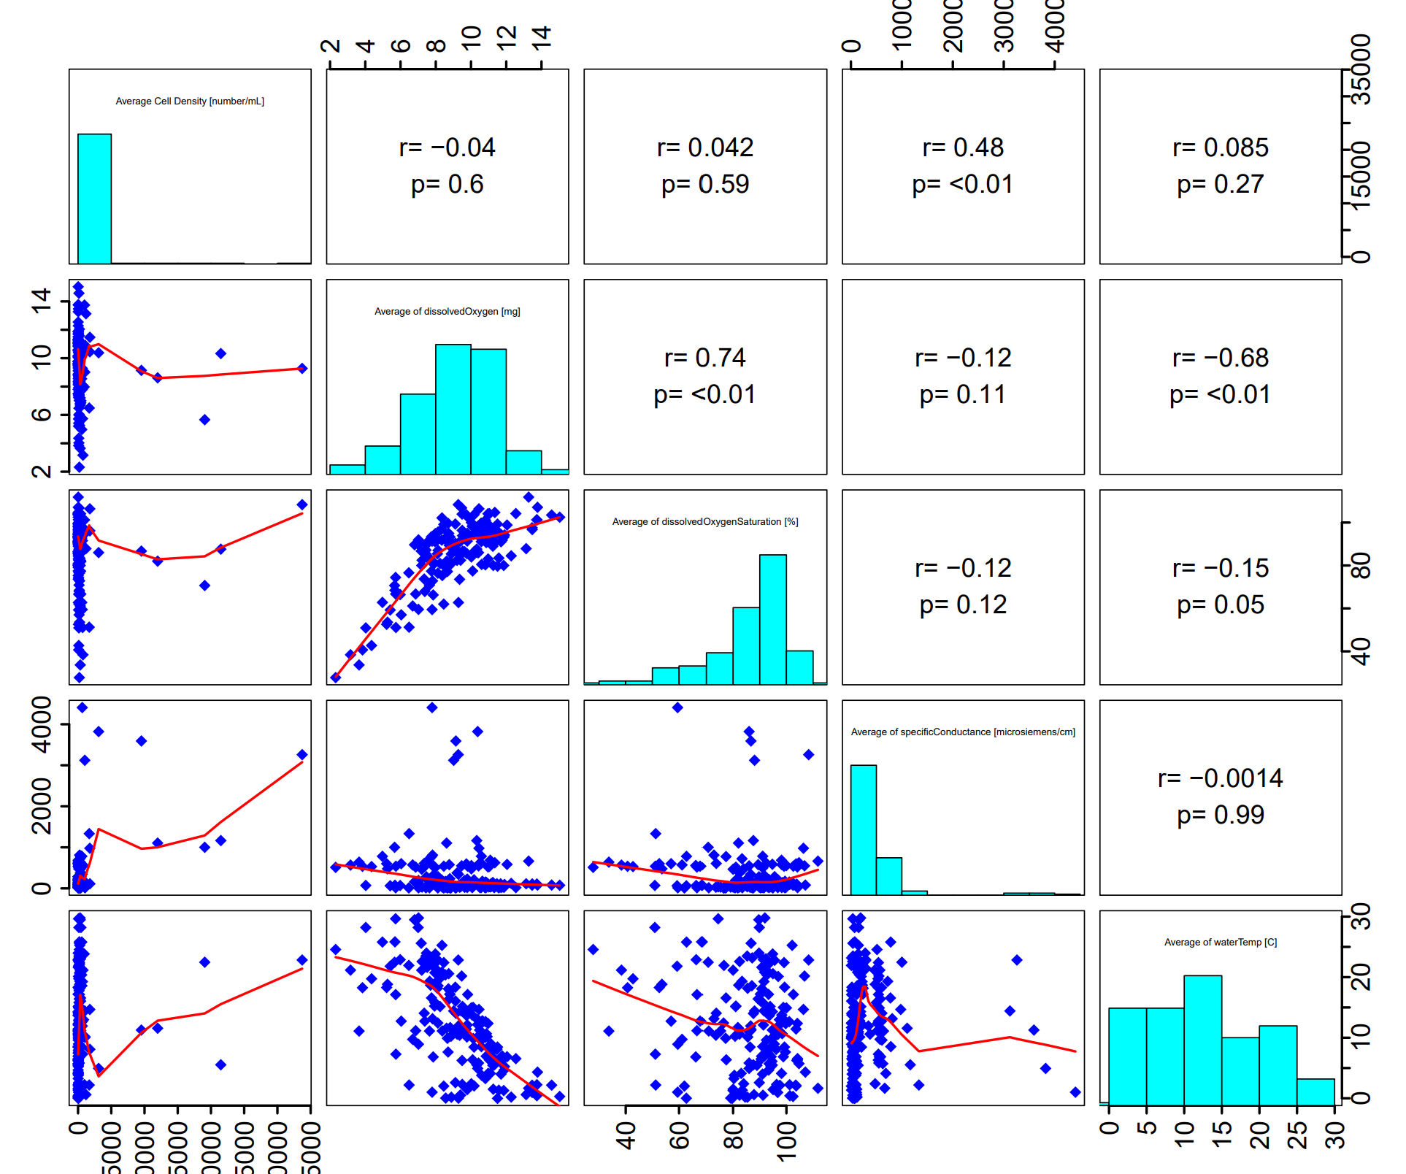
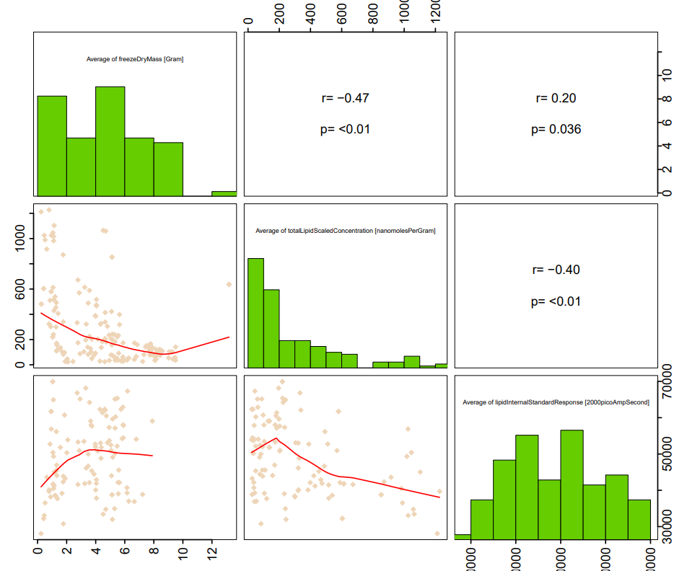
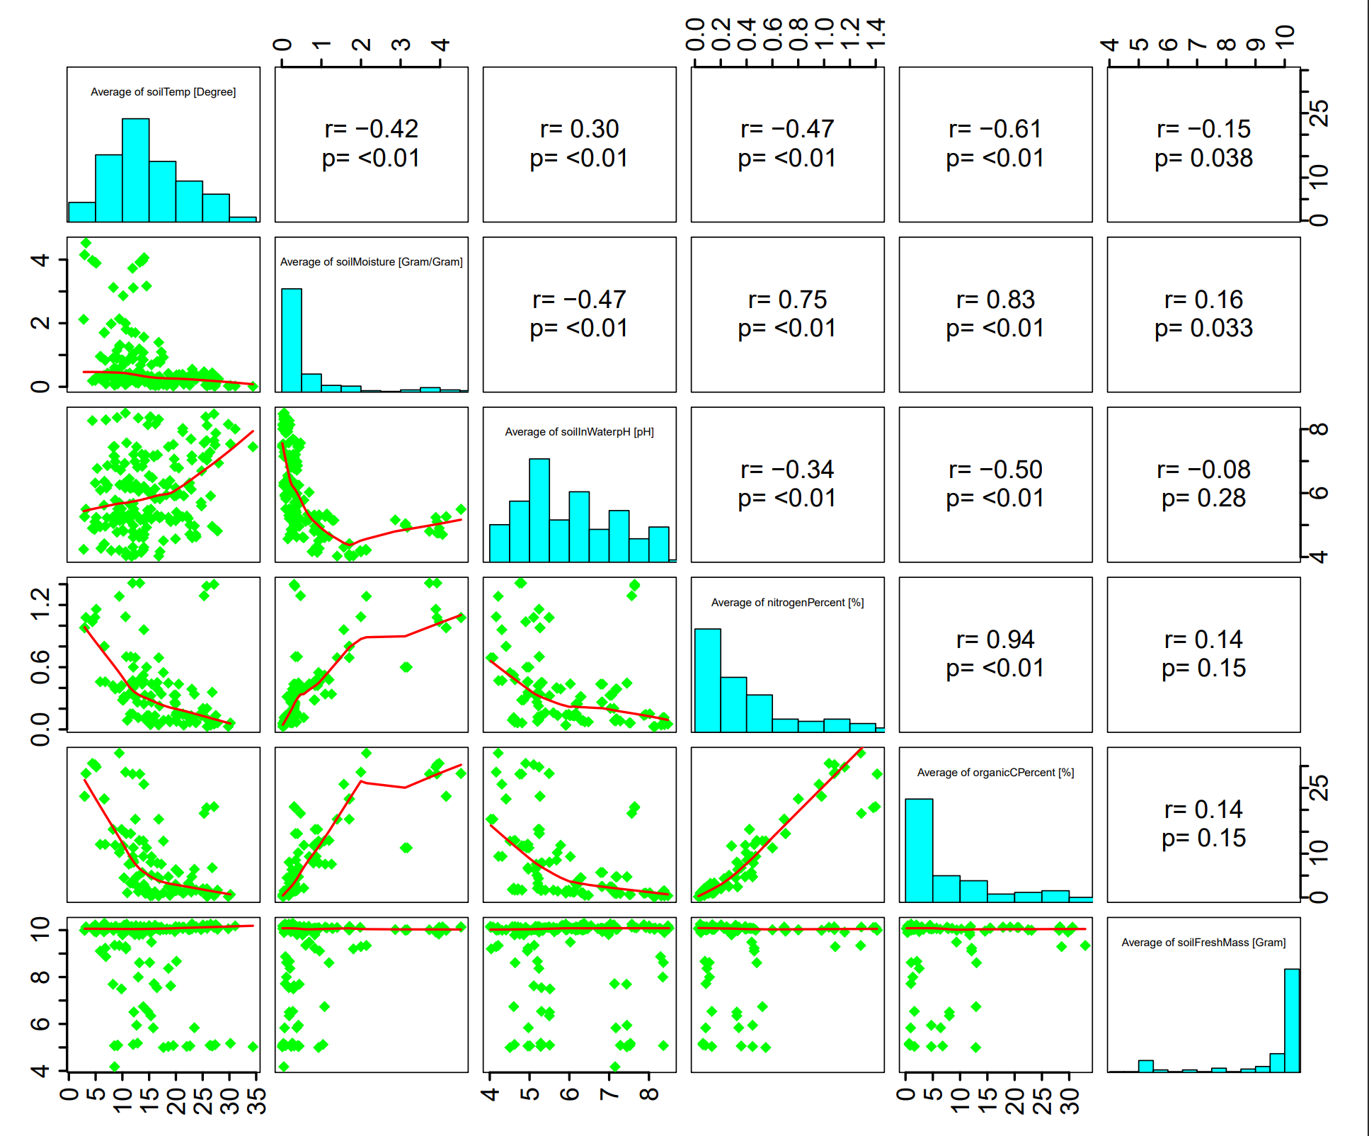

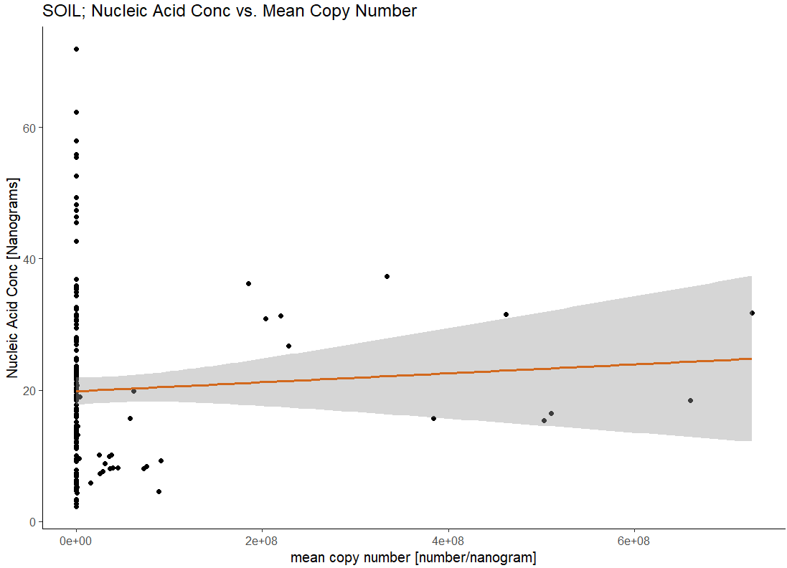
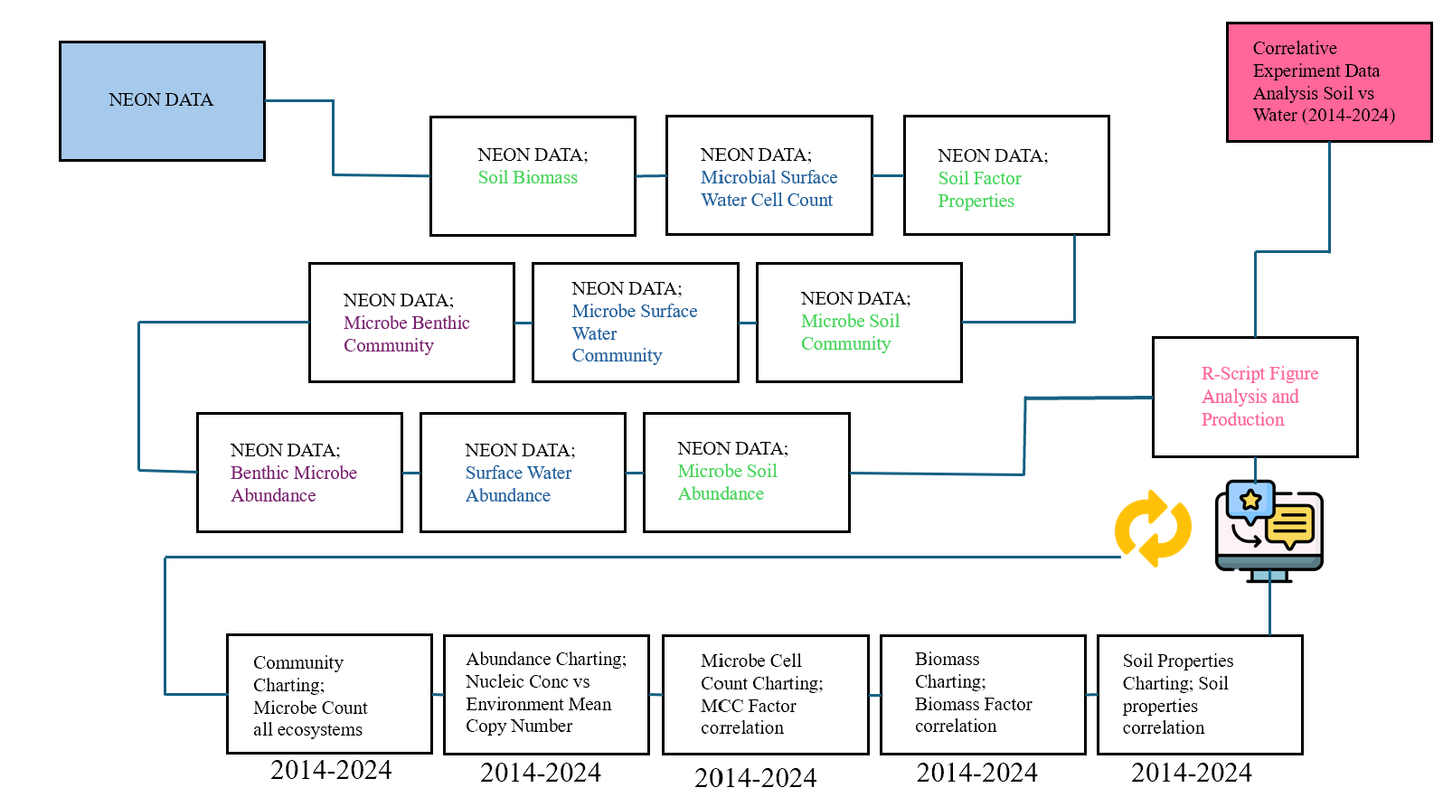
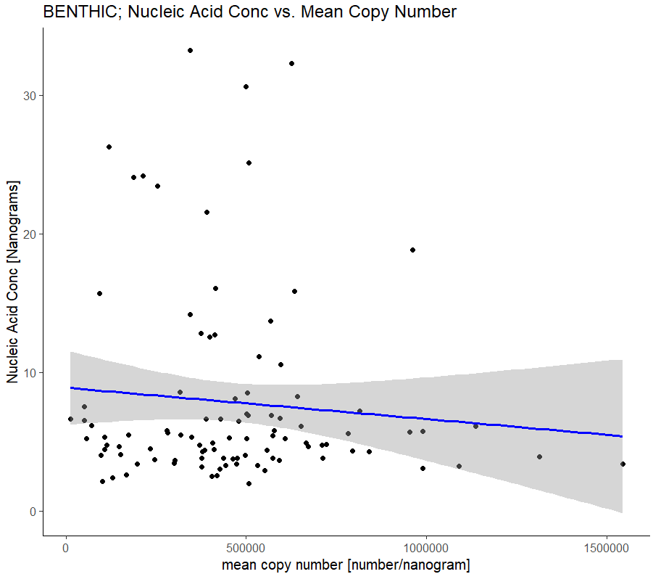
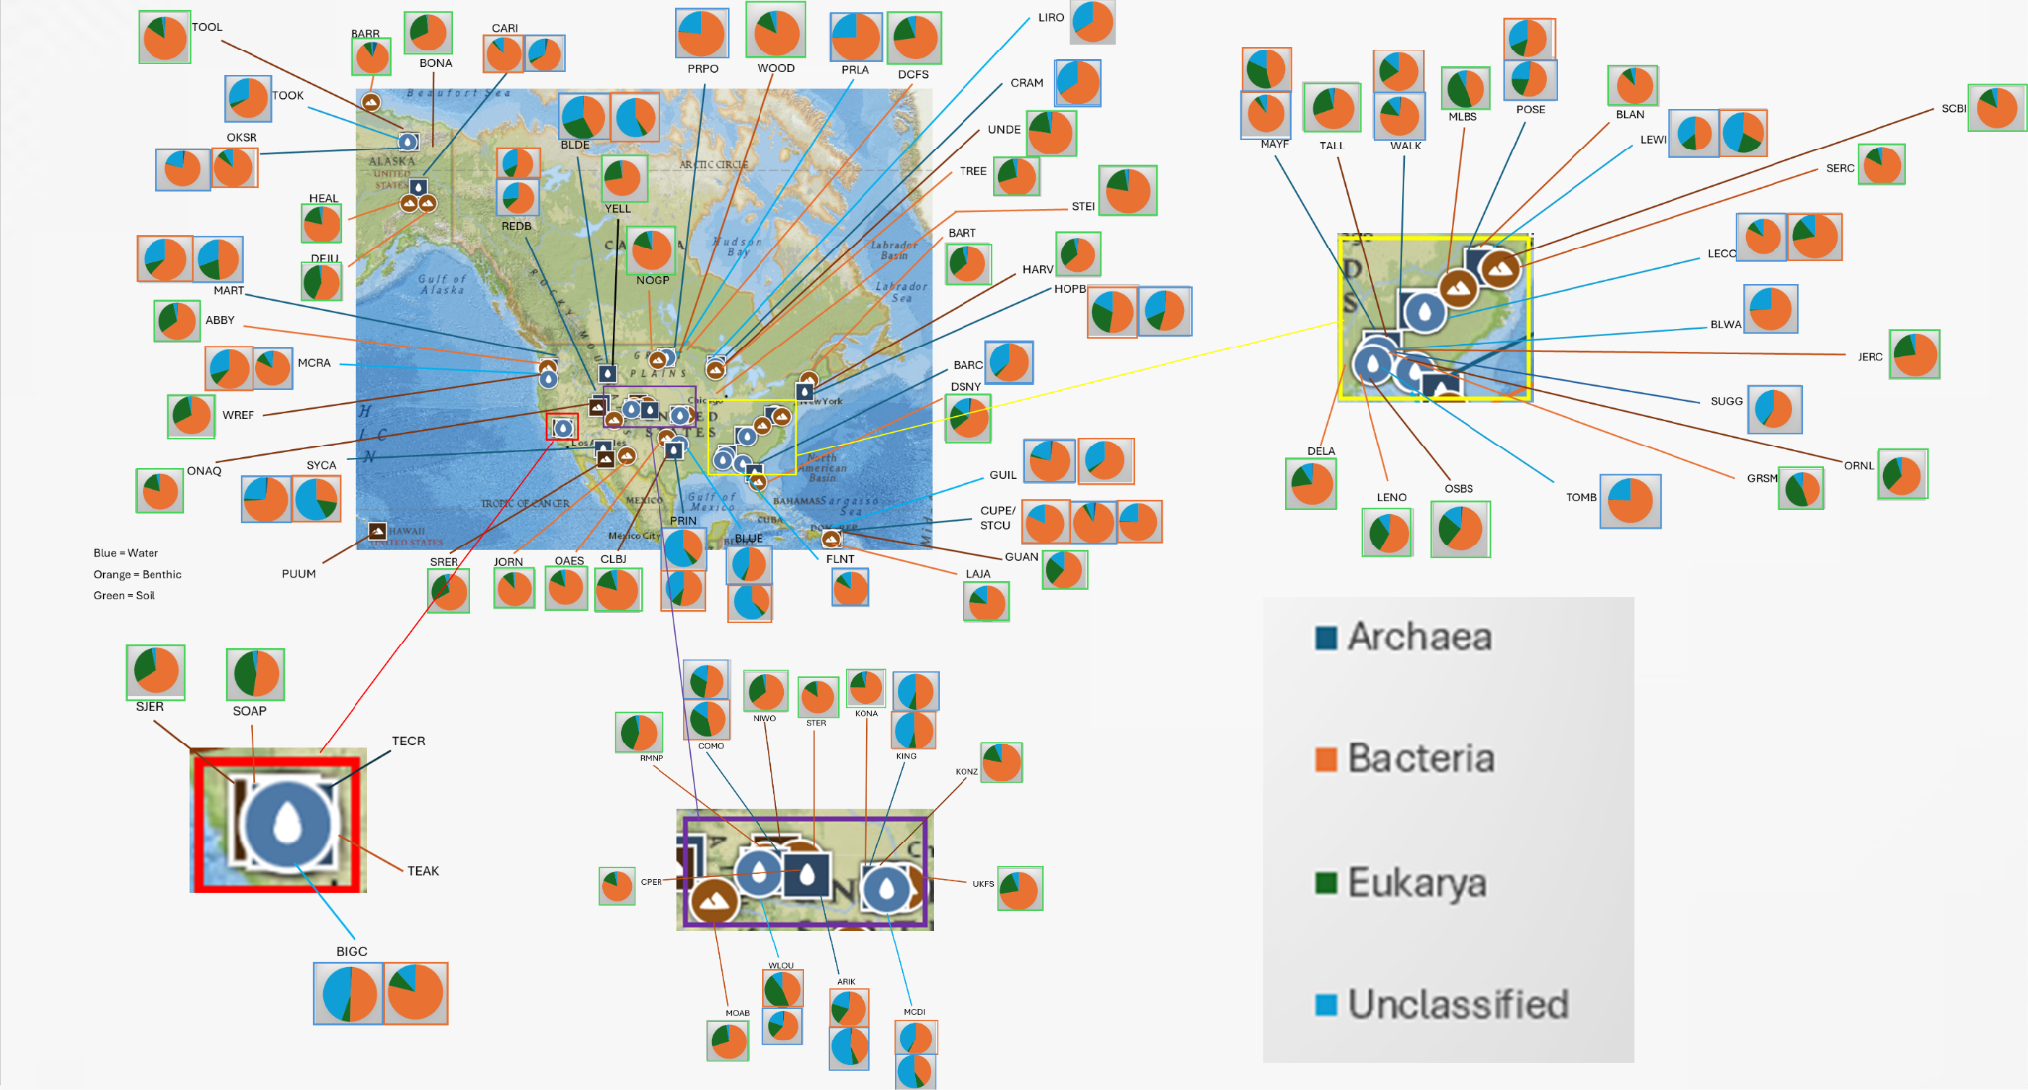
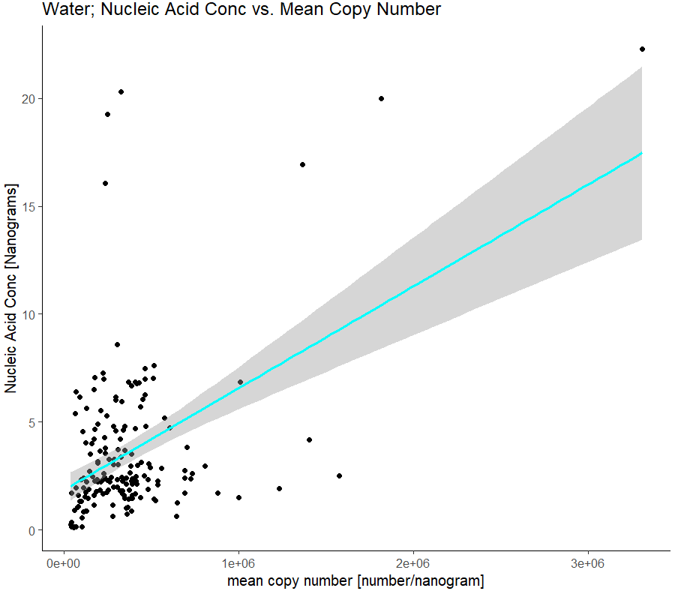
Data integration to investigate the decline of Soil Microbial Biomass and Aquatic Microbial Cell Density and its causes
Leo Sai^{1,} Xiaofeng Xu^{1,} , David Lipson¹
1. Biology Department, San Diego State University, San Diego, CA, USA; 2. National Ecological Observatory Network, CO, USA
Microbial/Biomass Correlation in Aquatic and Terrestrial Ecosystems
Model Plan/Implementation
2b)
2c)
Multiple R-squared: 0.003428, Adjusted R-squared: -0.002685
F-statistic: 0.5608 on 1 and 163 DF, p-value: 0.455
Figure 4a) Relatively weak correlation between Nucleic Acid Concentration and Mean copy number in soil
Figure 2. Relative variation in seasonal temporal scale in correlation to microbial cell density in aquatic systems and biomass in terrestrial systems.
Figure 2a) There is a clear correlation between specific conductance and water temperature that contribute to the microbial cell density in various sites within the USA in the aquatic ecosystem
Figure 2b) Large variation in biomass that accept the null hypothesis of all contributing factors like freeze-dry mass, lipid concentration, and lipid response providing insight that biomass has no significant correlation between any of the displayed factors.
Figure 2c) There is a clear correlation between soil moisture and soil temperature that contribute to the biomass in various sites within the USA in the terrestrial ecosystem with major factors in both aquatic and terrestrial ecosystems being temperature as a significant contributor to their respective communities.
4a)
1a)
2a)
4b)
Multiple R-squared: 0.008331, Adjusted R-squared: -0.001892
F-statistic: 0.8149 on 1 and 97 DF, p-value: 0.3689
Figure 4b) Relatively negative correlation between Nucleic Acid Concentration and Mean copy number in benthic waters
Take home message
At a monthly scale, specific conductance and water temperature are major controlling factors on microbial cell count in aquatic ecosystems.
At a monthly scale, soil moisture and soil temperature are major factors on biomass in terrestrial ecosystems.
A relatively weak seasonal variation indicates microbial abundance to all types environmental conditions over seasons in both aquatic and terrestrial ecosystems to their respective communities (data shown in figure)
Relatively positive correlation between Nucleic Acid Concentration with Mean Copy Number indicates accurate interpretation of qPCR data and method validation
Further research is needed to investigate the pattern variations across space and over time in horizontal and vertical abundance of Biomass and Microbial Cell Density.
3a)
4c)
Multiple R-squared: 0.2206, Adjusted R-squared: 0.216
F-statistic: 47.56 on 1 and 168 DF, p-value: 1.034e-10
Figure 4c) Relatively negative correlation between Nucleic Acid Concentration and Mean copy number in aquatic systems
Acknowledgments:
This study has been supported by an NSF CAREER project (2145130). We acknowledge the operation of the NEON supported by the NSF.
Figure 3. Descriptive Location of sampling sites taken from the NEON Domain with population percentages in parts of the USA

Slide 2


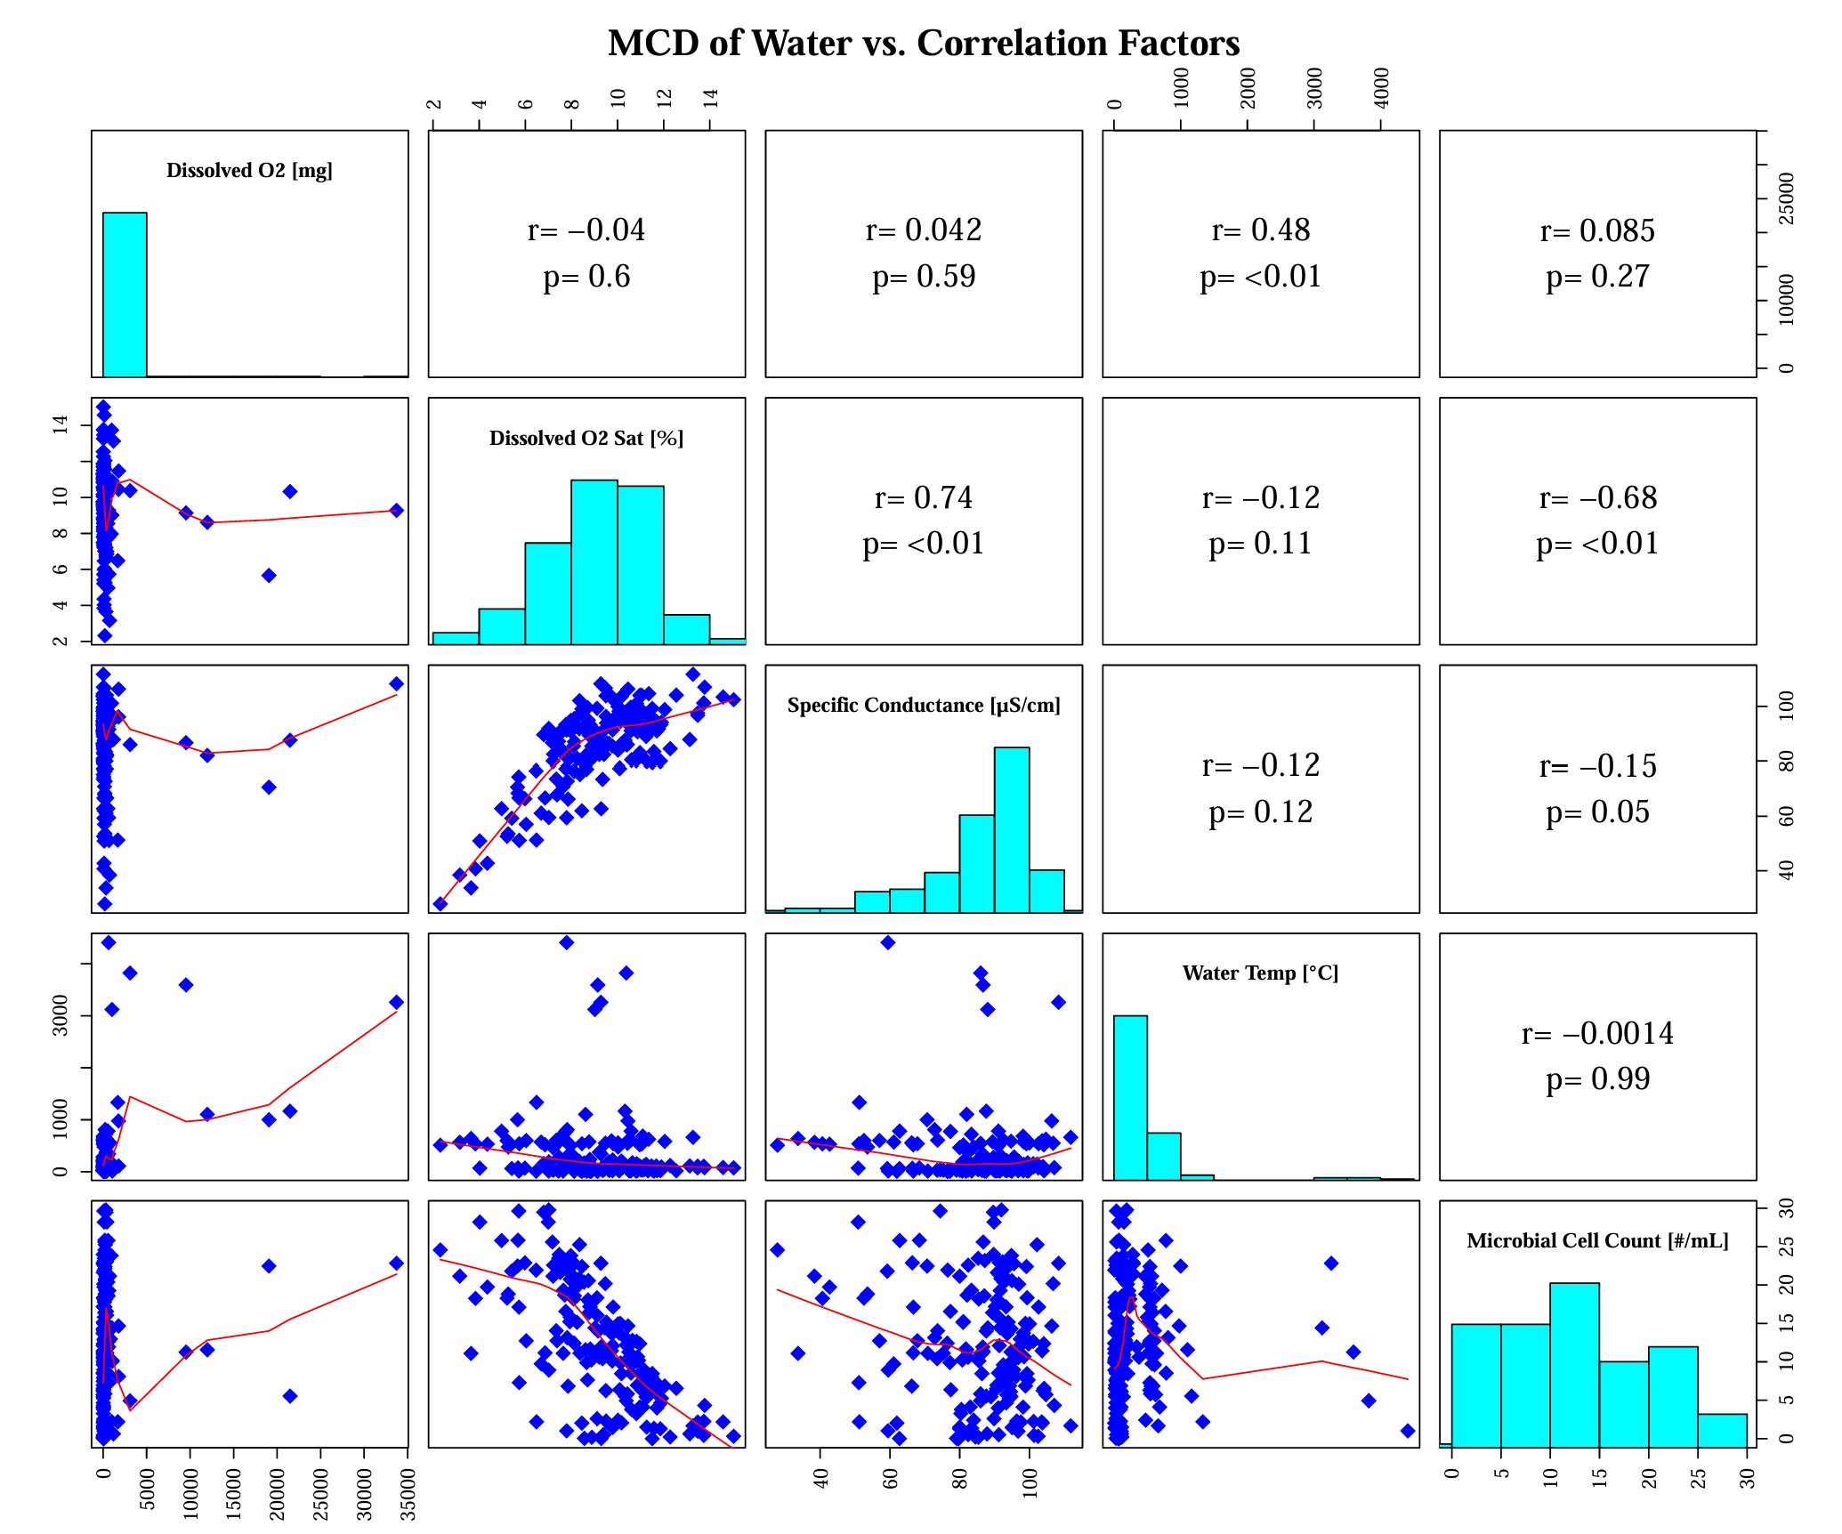
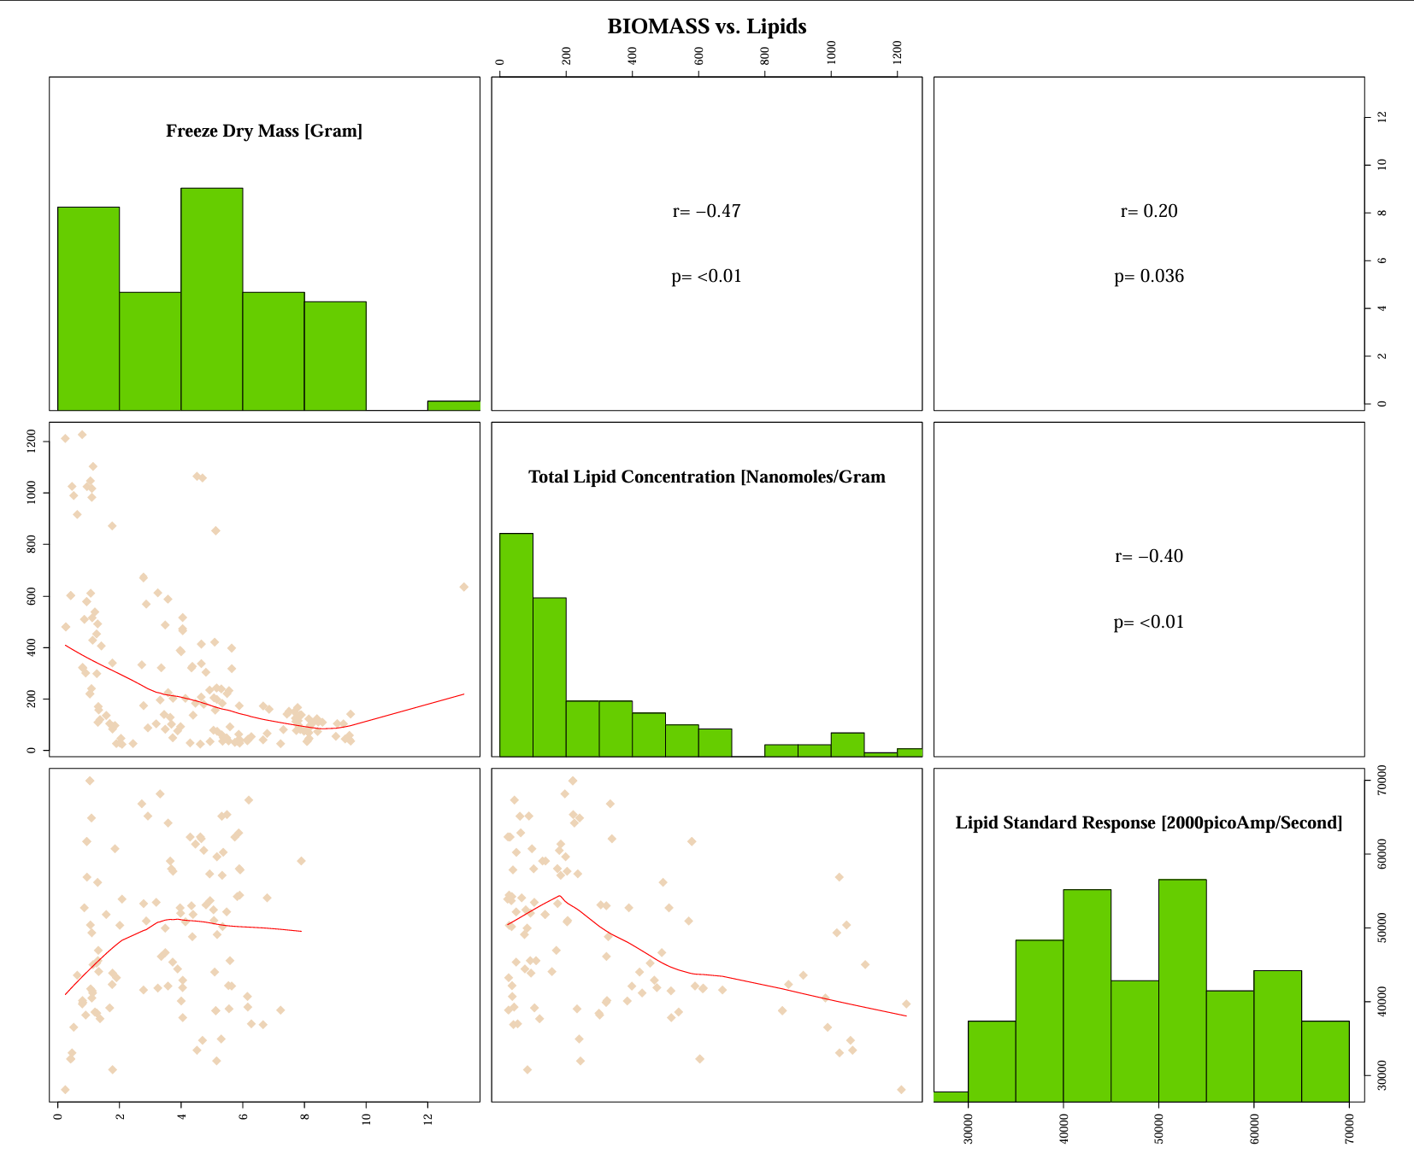
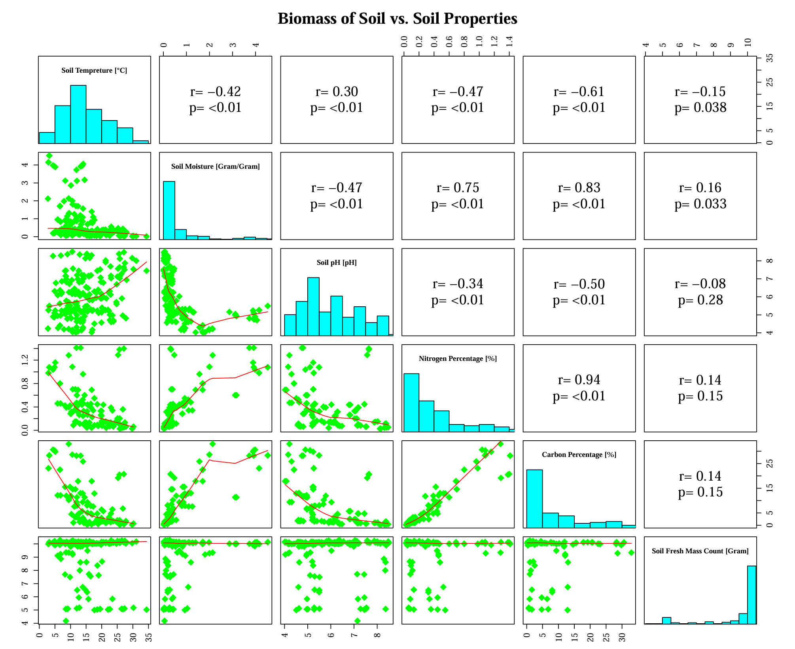
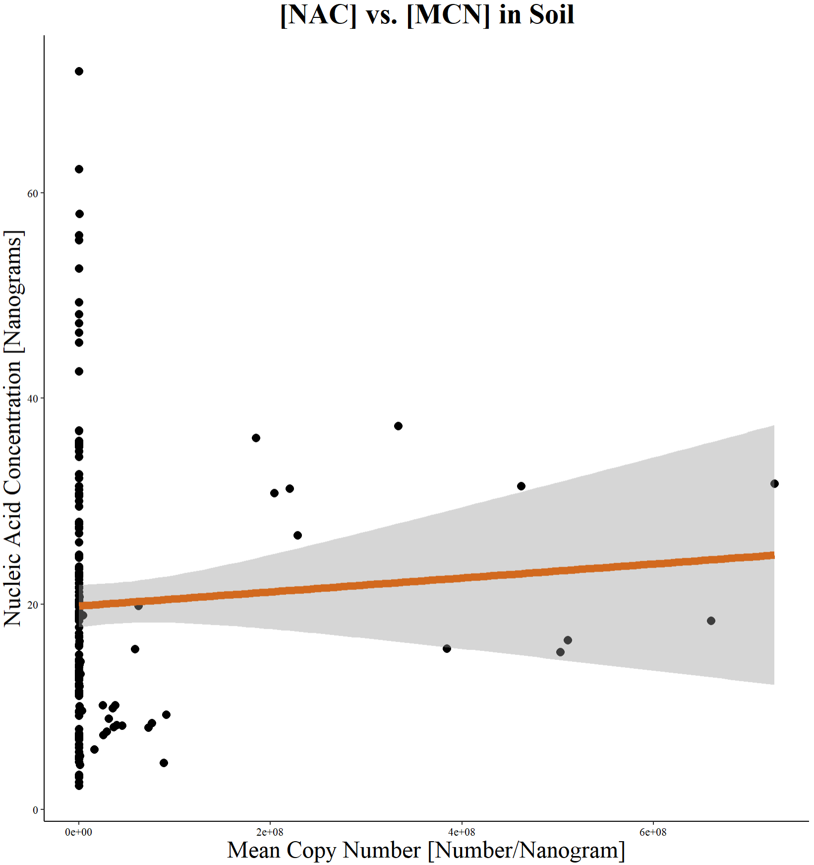
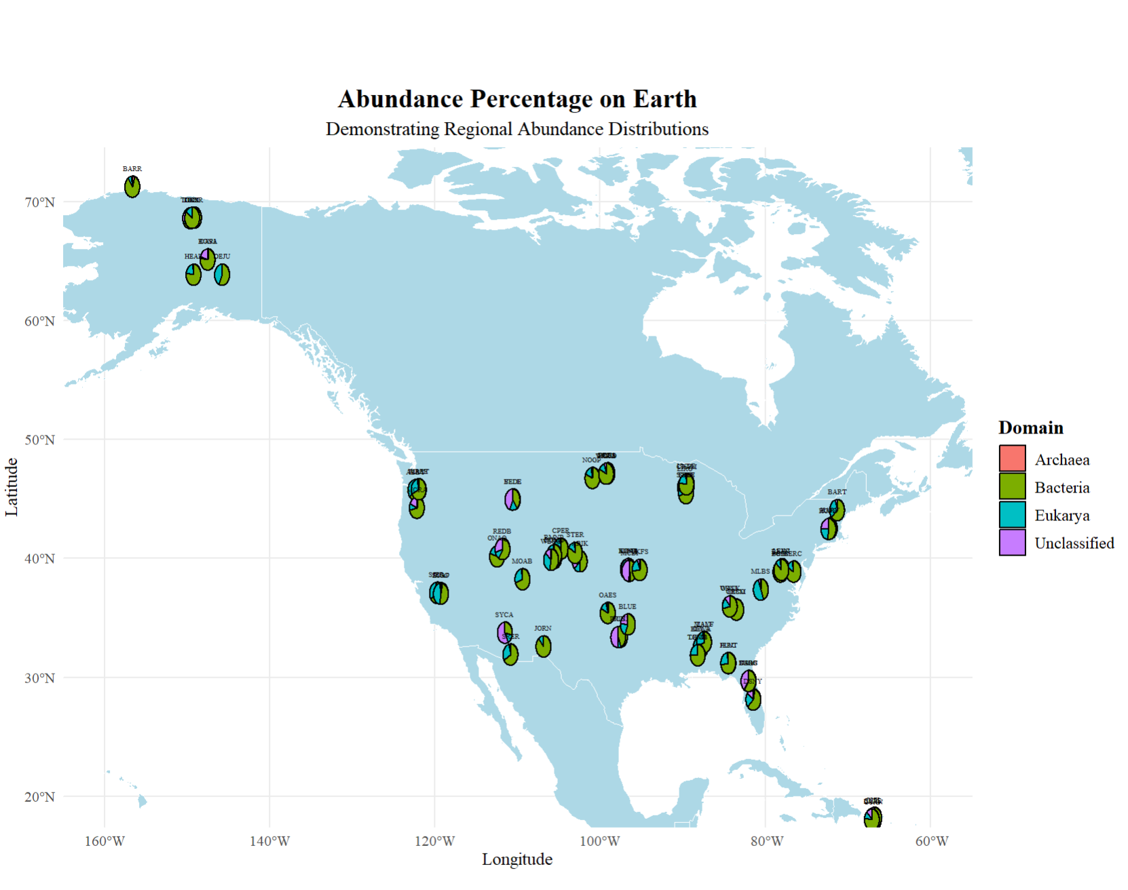
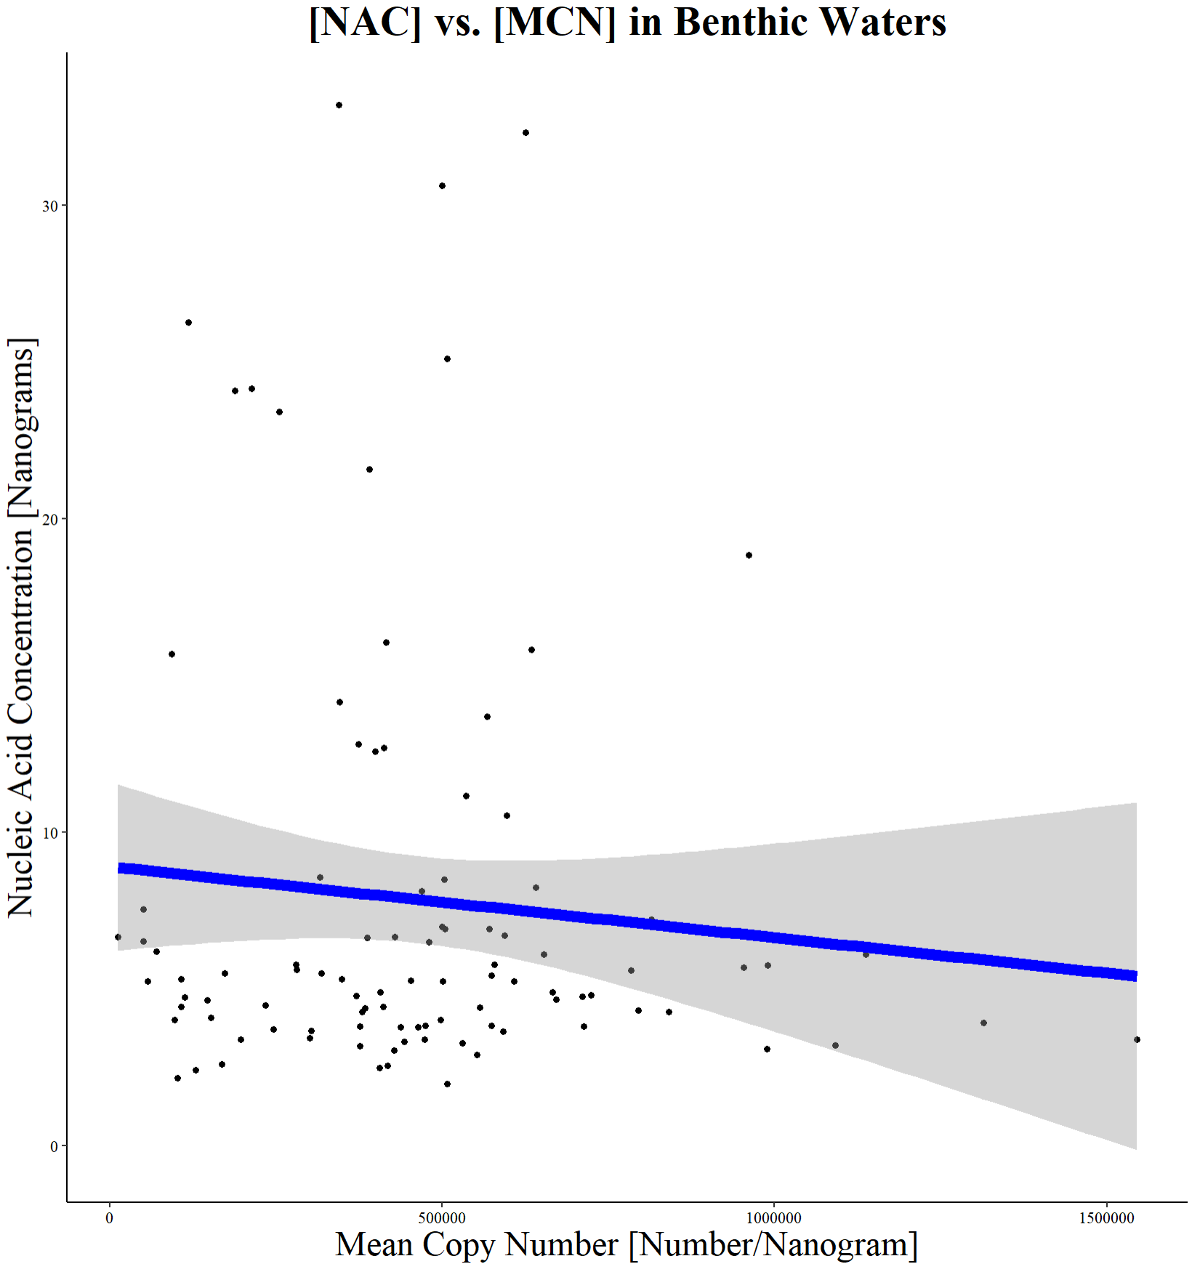
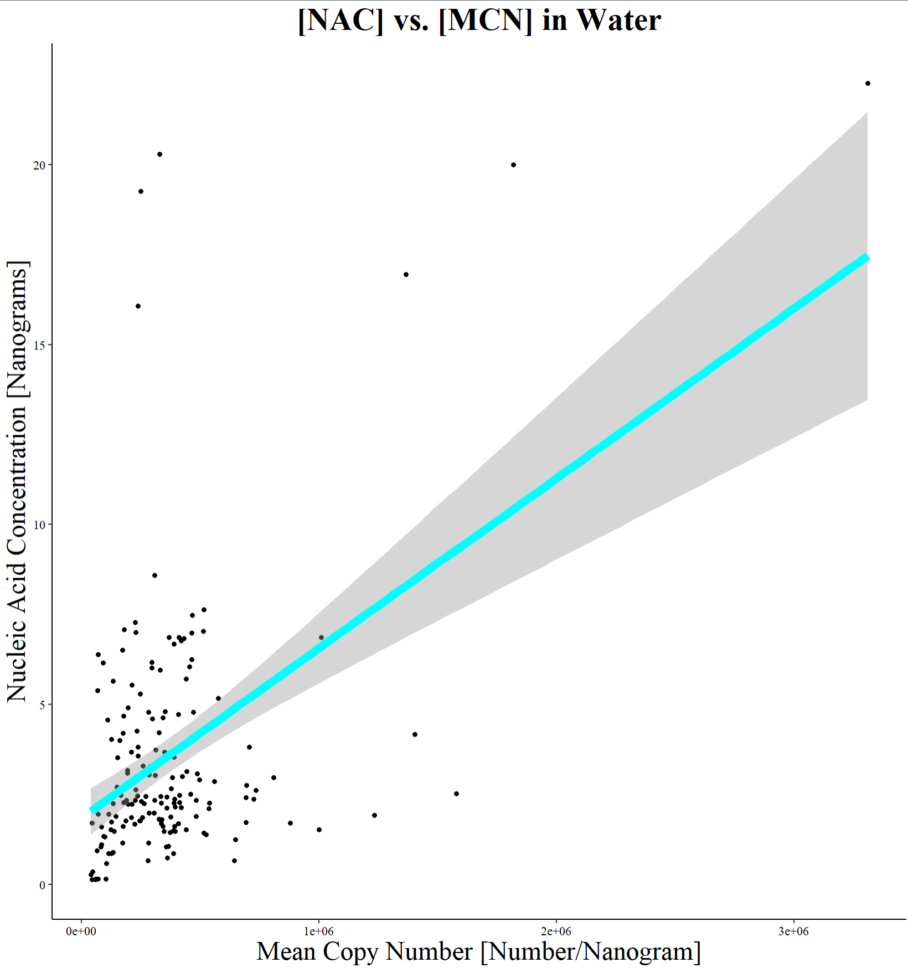
Data integration to investigate Microbial Abundance in Terrestrial and Aquatic Ecosystems and its Causes
Leo Sai^{1,} Xiaofeng Xu^{1,} , David Lipson¹
1. Biology Department, San Diego State University, San Diego, CA, USA; 2. National Ecological Observatory Network, CO, USA
Multiple R-squared: 0.003428, Adjusted R-squared: -0.002685
F-statistic: 0.5608 on 1 and 163 DF, p-value: 0.455
Figure 4a) Relatively weak correlation between Nucleic Acid Concentration and Mean copy number in soil
Multiple R-squared: 0.008331, Adjusted R-squared: -0.001892
F-statistic: 0.8149 on 1 and 97 DF, p-value: 0.3689
Figure 4b) Relatively negative correlation between Nucleic Acid Concentration and Mean copy number in benthic waters
Multiple R-squared: 0.2206, Adjusted R-squared: 0.216
F-statistic: 47.56 on 1 and 168 DF, p-value: 1.034e-10
Figure 4c) Relatively positive correlation between Nucleic Acid Concentration and Mean copy number in aquatic systems

Slide 3
Notes/ Reviewed:
36 height 48/60 wide
Fix the figure numbering
Title = 32/36 size font and 28/24 font text b/c when you print
Caption after the figure (legend)
Result, etc. (format similar to lab reports)
Summarize all figures and reorganize

